Slide 1
Angular JS
OM ASHISH MISHRA
16BCE0789
E2

Slide 2
Introduction
AngularJS is a structural framework for dynamic web apps. It lets you use HTML as your template language and lets you extend HTML's syntax to express your application's components clearly and succinctly. Angular's data binding and dependency injection eliminate much of the code you currently have to write. And it all happens within the browser, making it an ideal partner with any server technology.

Slide 3
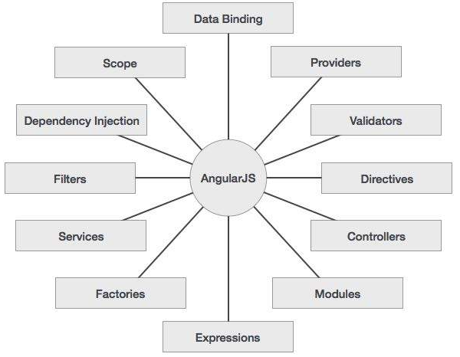
Core Features

Slide 4
AngularJS Main Components
ng-app − This directive defines and links an AngularJS application to HTML.
ng-model − This directive binds the values of AngularJS application data to HTML input controls.
ng-bind − This directive binds the AngularJS Application data to HTML tags.

Slide 5
Include AngularJS
We have included the AngularJS JavaScript file in the HTML page so we can use AngularJS −
<head> <script src = "https://ajax.googleapis.com/ajax/libs/angularjs/1.4.8/angular.min.js"></script> </head>

Slide 6
MVC
Model View Controller or MVC as it is popularly called, is a software design pattern for developing web applications. A Model View Controller pattern is made up of the following three parts −
Model − It is the lowest level of the pattern responsible for maintaining data.
View − It is responsible for displaying all or a portion of the data to the user.
Controller − It is a software Code that controls the interactions between the Model and View.

Slide 7
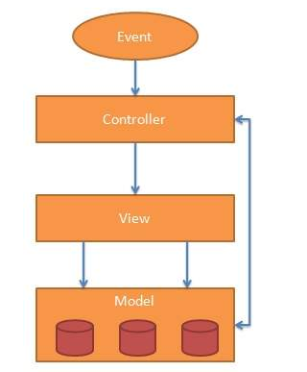

Slide 8
Point to AngularJS app
Next we tell what part of the HTML contains the AngularJS app. This done by adding the ng-app attribute to the root HTML element of the AngularJS app. You can either add it to html element or body element as shown below −
<body ng-app = "myapp"> </body>

Slide 9
View
The view is this part −
<div ng-controller = "HelloController" > <h2>Welcome {{helloTo.title}} to the world of Frontend!</h2> </div>ng-controller tells AngularJS what controller to use with this view. helloTo.titletells AngularJS to write the "model" value named helloTo.title to the HTML at this location.

Slide 10
Controller
The controller part is −
<script> angular.module("myapp", []) .controller("HelloController", function($scope) { $scope.helloTo = {}; $scope.helloTo.title = "AngularJS"; }); </script>This code registers a controller function named HelloController in the angular module named myapp. We will study more about modules and controllers in their respective chapters. The controller function is registered in angular via the angular.module(...).controller(...) function call.
The $scope parameter passed to the controller function is the model. The controller function adds a helloTo JavaScript object, and in that object it adds a title field.

Slide 11
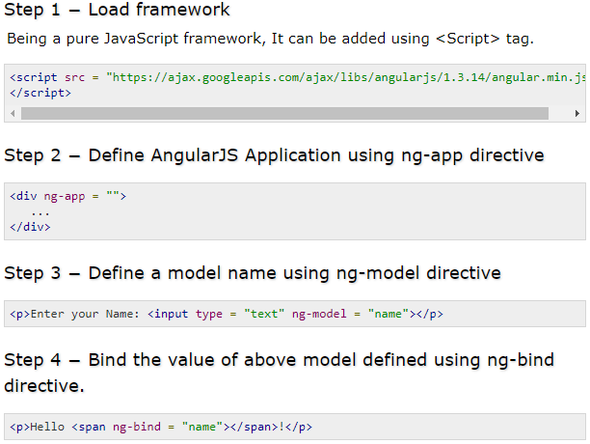
Steps to create AngularJS Application

Slide 12
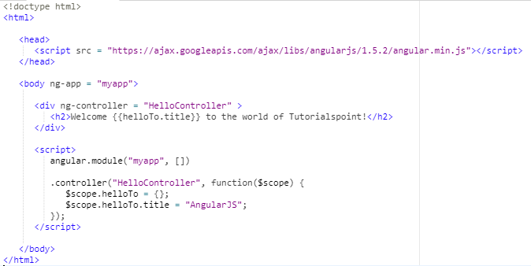
Example

Slide 13
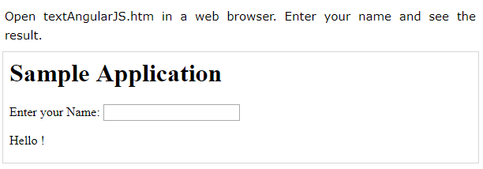
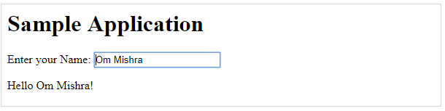
Output

Slide 14
Angular JS Directive
AngularJS directives are used to extend HTML.
ng-app − This directive starts an AngularJS Application.
ng-init − This directive initializes application data.
ng-model − This directive binds the values of AngularJS application data to HTML input controls.
ng-repeat − This directive repeats html elements for each item in a collection.

Slide 15
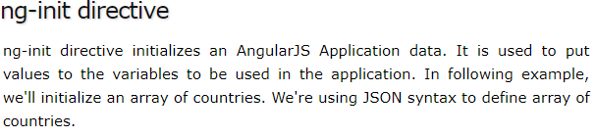
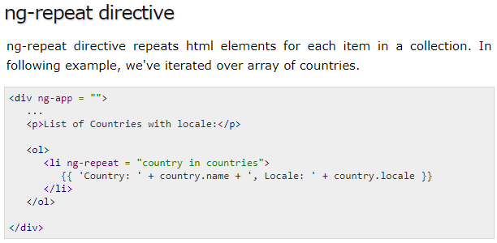
<div ng-app = "" ng-init = "countries = [{locale:'en-US',name:'United States'}, {locale:'en-GB',name:'United Kingdom'}, {locale:'en-FR',name:'France'}]"> ... </div>

Slide 16
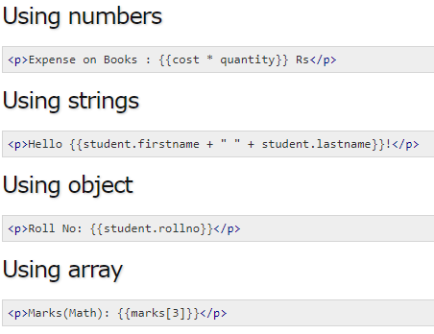
Expressions Expressions are used to bind application data to html.

Slide 17
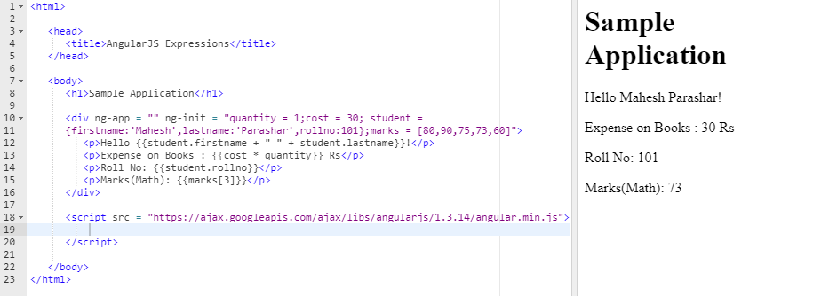

Slide 18
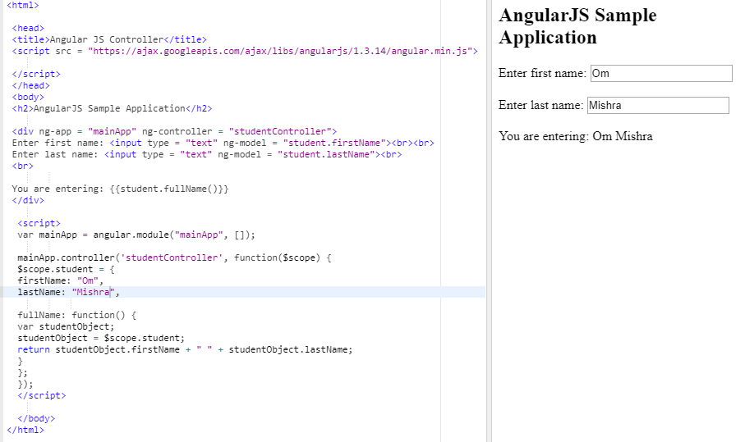
Controller

Slide 19
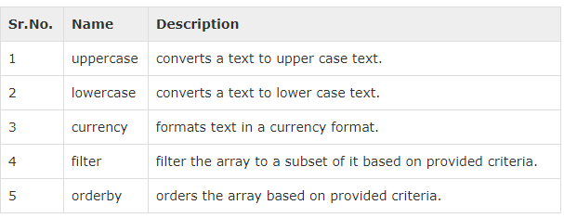
Filters
Filters are used to change modify the data and can be clubbed in expression or directives using pipe character.

Slide 20
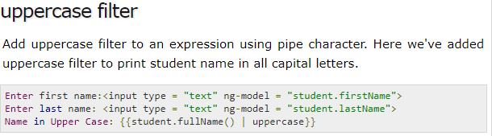
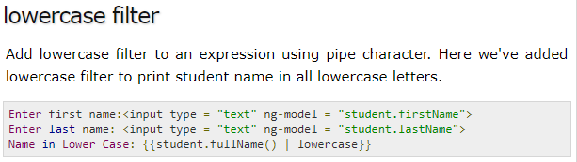
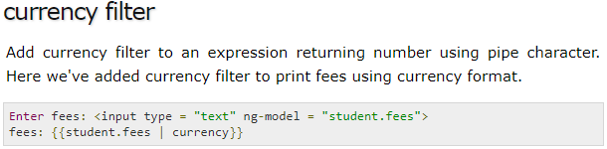
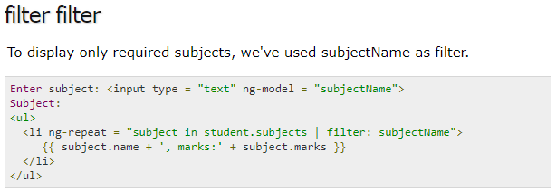

Slide 21
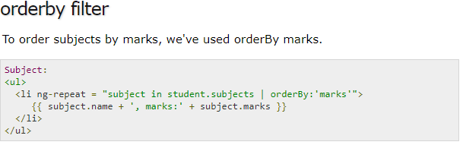
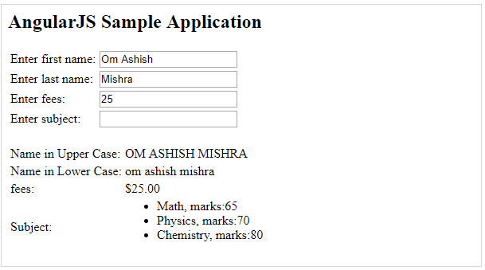
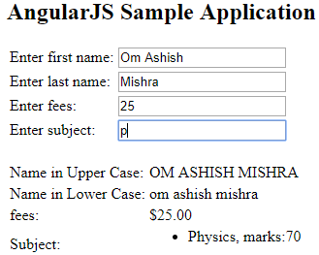

Slide 22
Advantages of Angular JS
Structure, Quality and Organization
Lightweight ( < 36KB compressed and minified)
Free
Separation of concern
Modularity
Extensibility & Maintainability
Reusable Components

Slide 23
Useful Links
https://angularjs.org/
http://campus.codeschool.com/courses/shaping-up-with-angular-js/contents
http://www.toptal.com/angular-js/a-step-by-step-guide-to-your-first-angularjs-app
https://github.com/raonibr/f1feeder-part1

